Slide 1
Introduction to visualization
Copyright McGraw Hill, Rosen, Discrete Mathematics and its Applications

Slide 2
Introduction to visualization
Visualization: any kind of visual representation of information designed to enable communication, analysis, discovery, exploration, etc.
Good data visualizations communicate information by:
Providing reliable information
Visually encoding it so relevant patterns become noticeable
Organizing it in a way that enables some exploration
Presenting it in an attractive manner

Slide 3
Types of visualizations
Chart: display in which data are encoded with symbols that have different shapes, colors, or proportions
Map: depiction of a geographical area or a representation of data that pertains to that area
Infographic: multi-section visual representation of information intended to communicate one or more specific messages

Slide 4
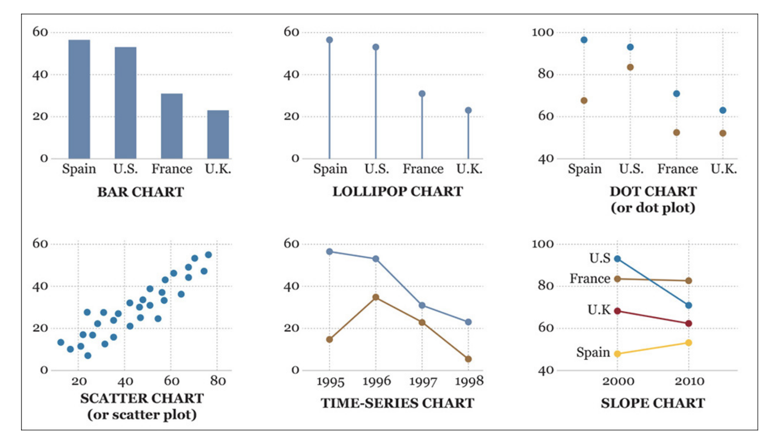
Examples of charts

Slide 5
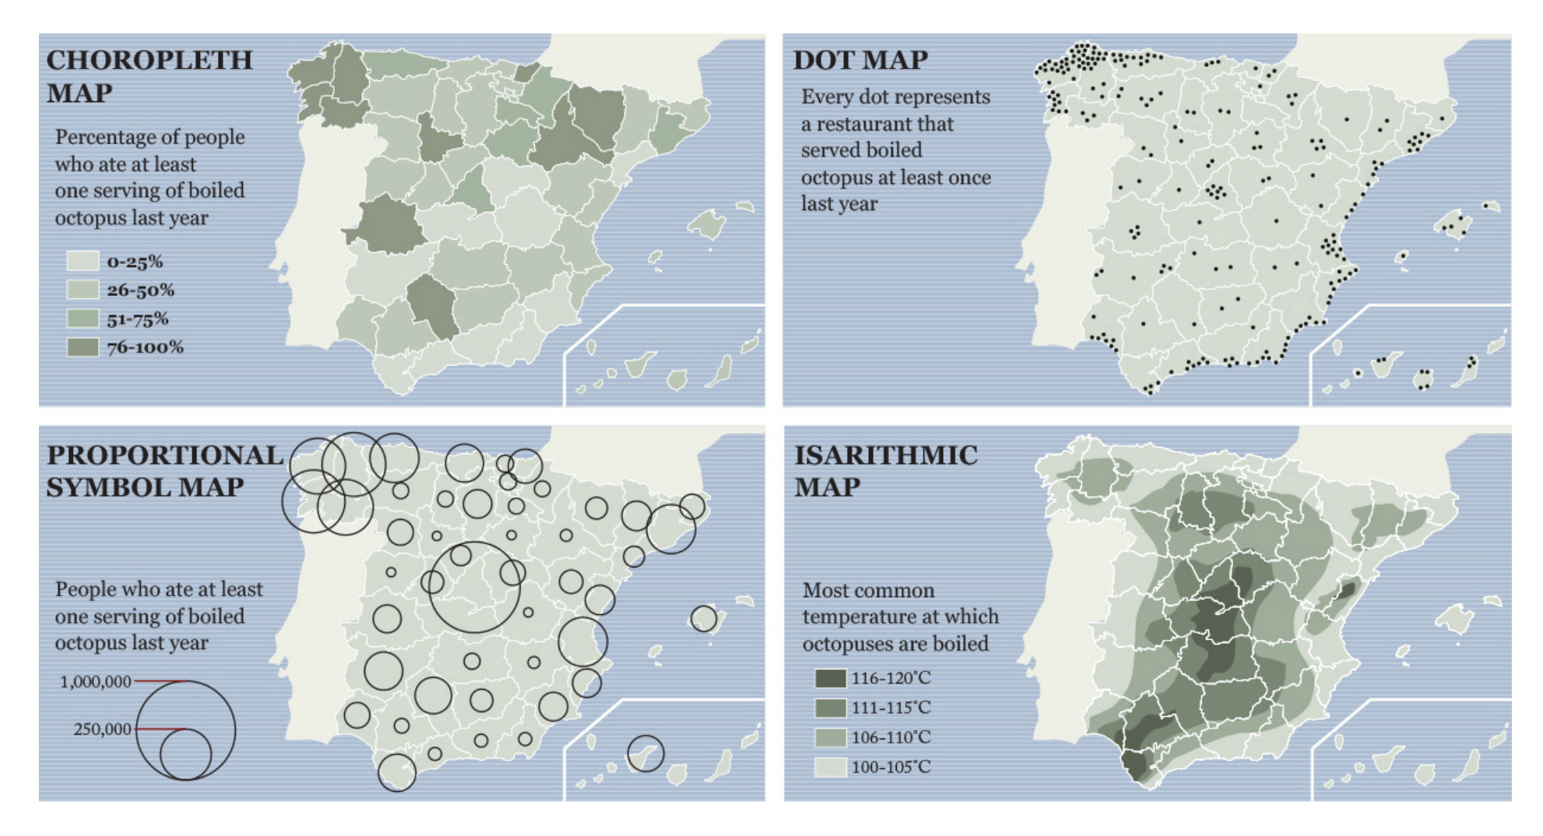
Examples of data maps

Slide 6
Example infographic

Slide 7
Qualities of great visualizations
Truthful: based on thorough and honest research
Functional: accurate description of data that lets people do meaningful operations based on it
Beautiful: intriguing and aesthetically pleasing (for intended audience)
Insightful: reveals evidence that we would have a hard time seeing otherwise

Slide 8
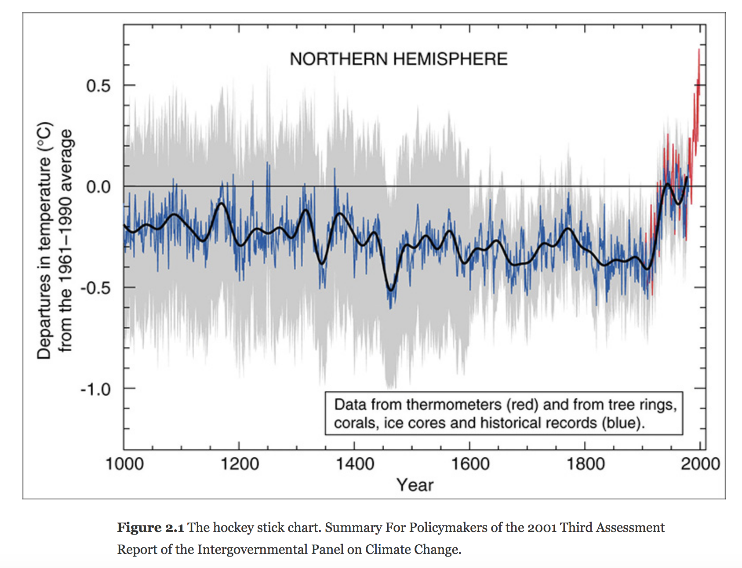
Example: Visualization success story

Slide 9
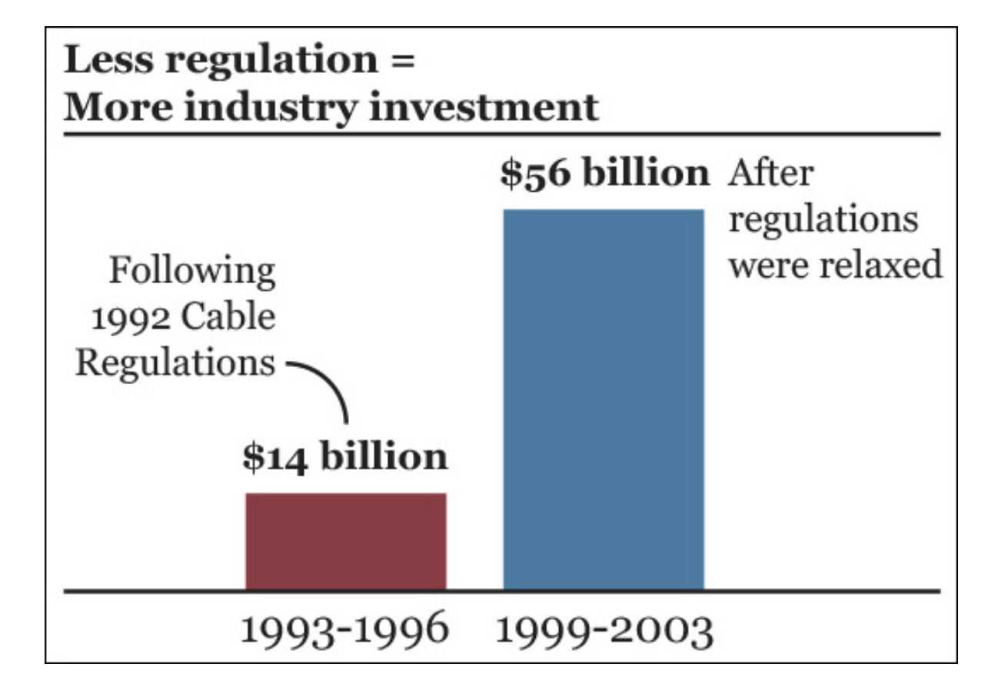
Truthful: What is wrong with this chart?
Start to read visualizations, don’t just look at them

Slide 10
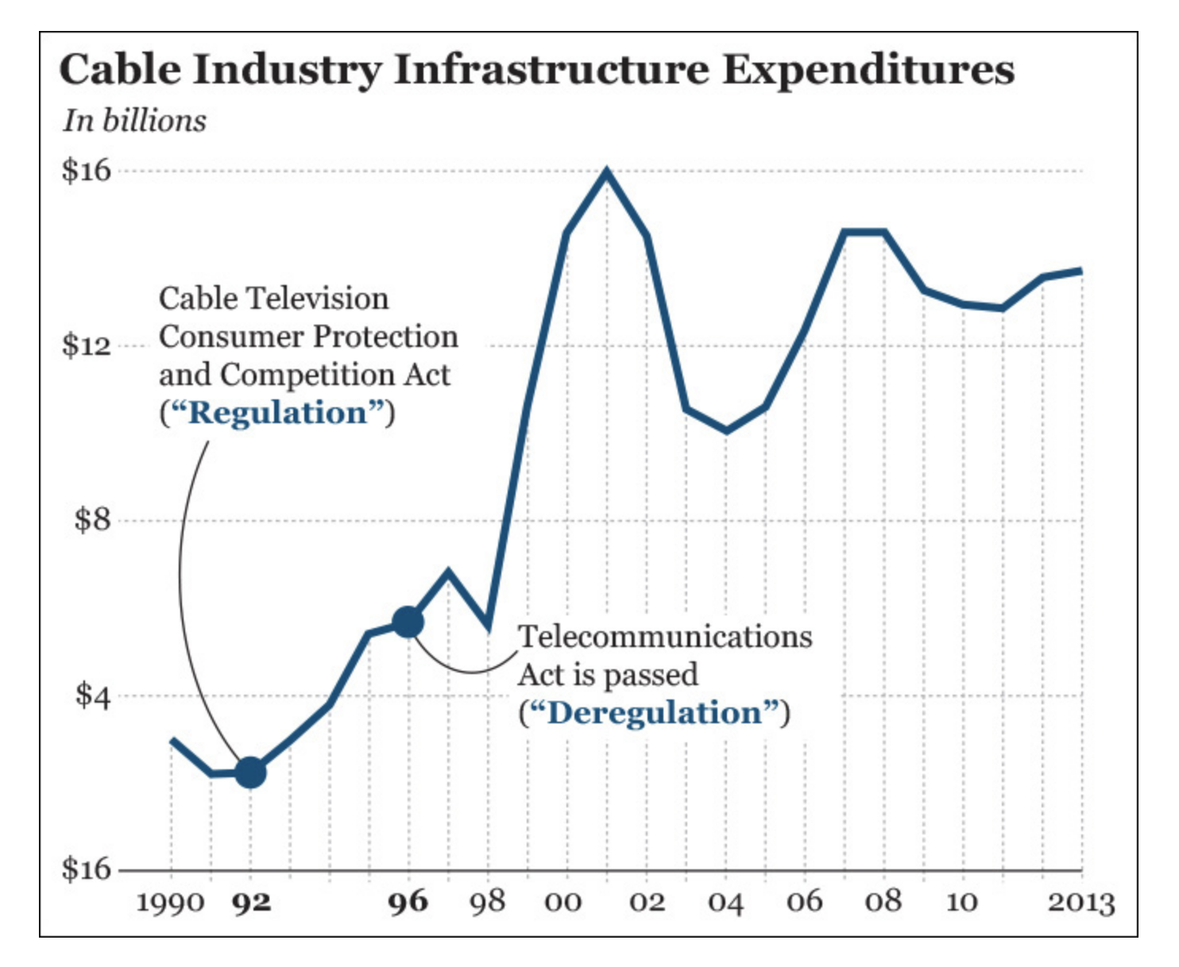
Conclusion changes with more information
If someone hides data from you, there’s probably a reason

Slide 11
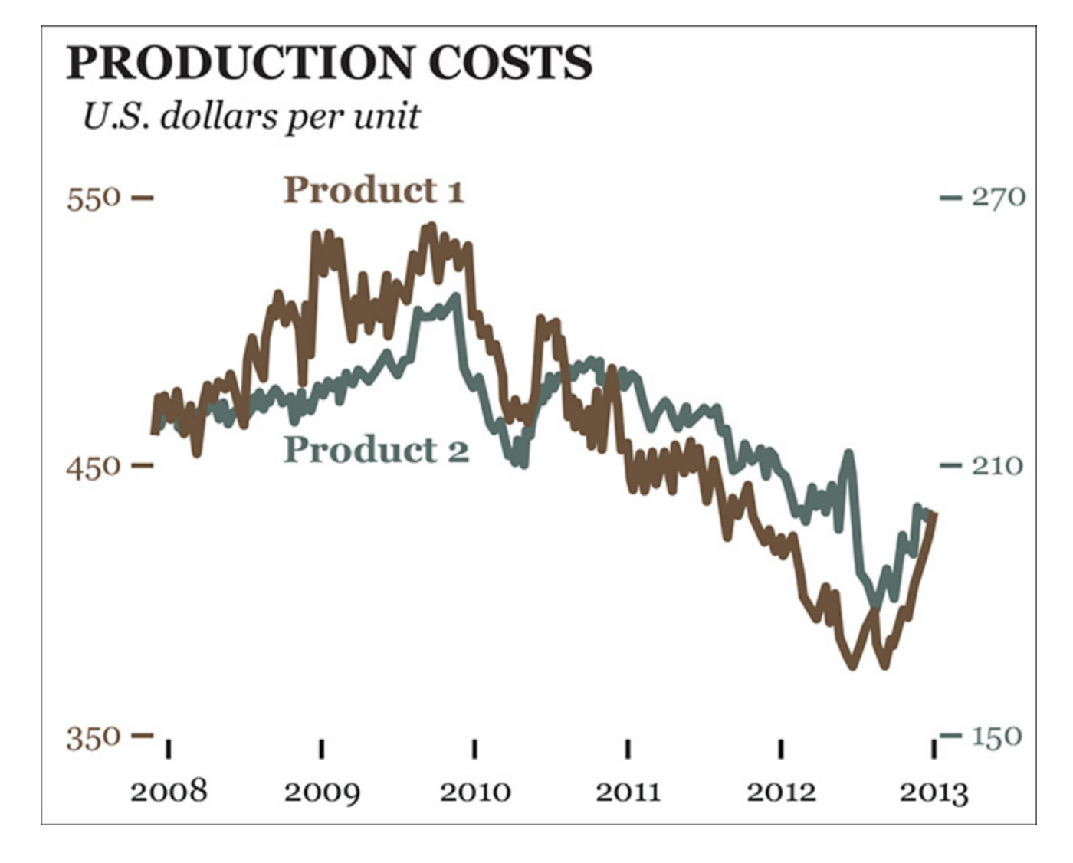
But truth is relative…
…and interacts with other design choices

Slide 12
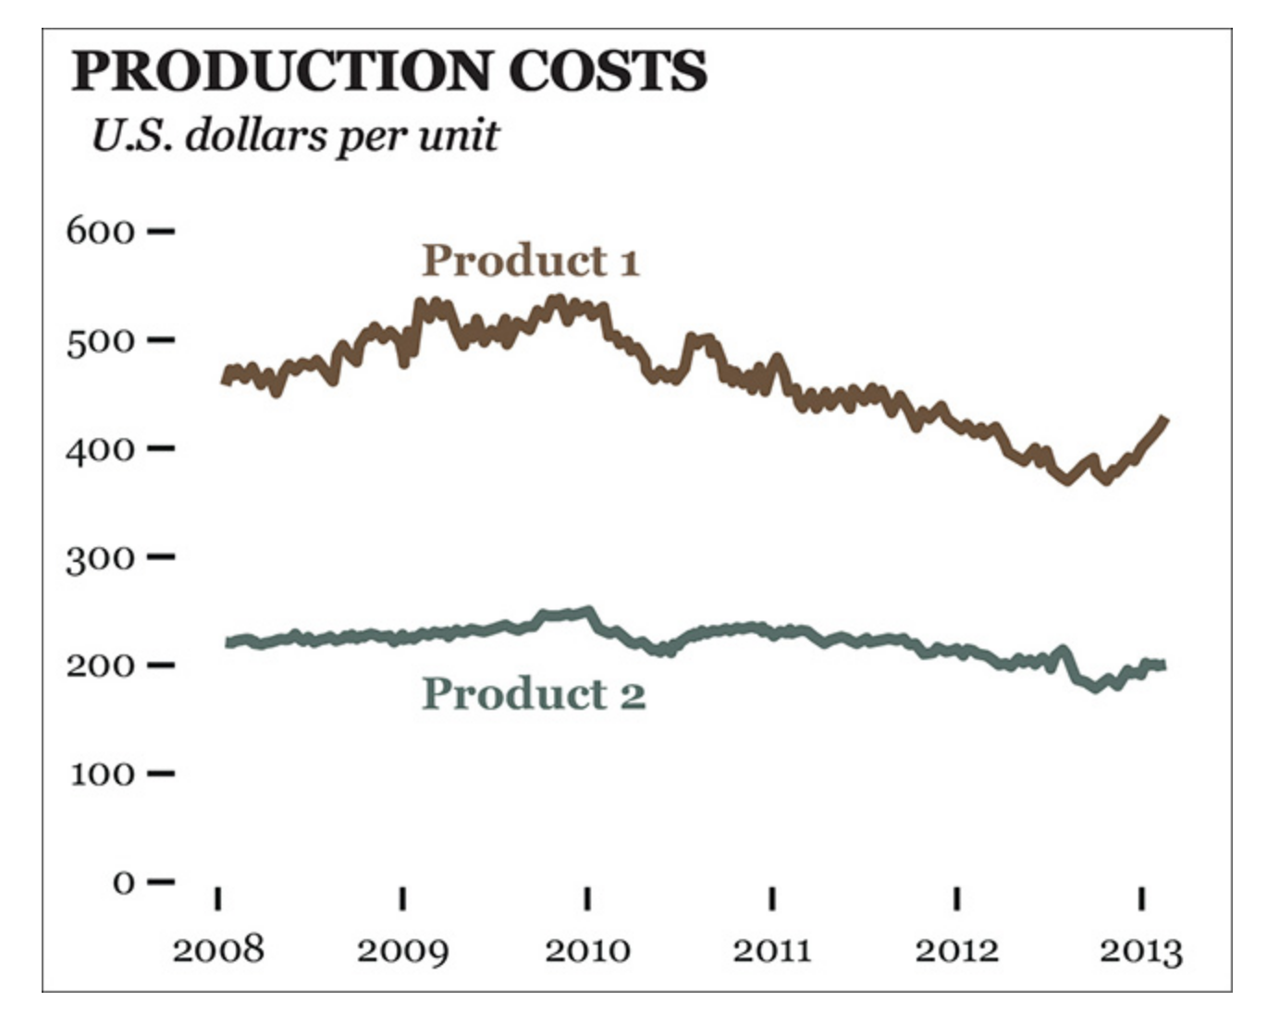
Same data, now on same scale

Slide 13
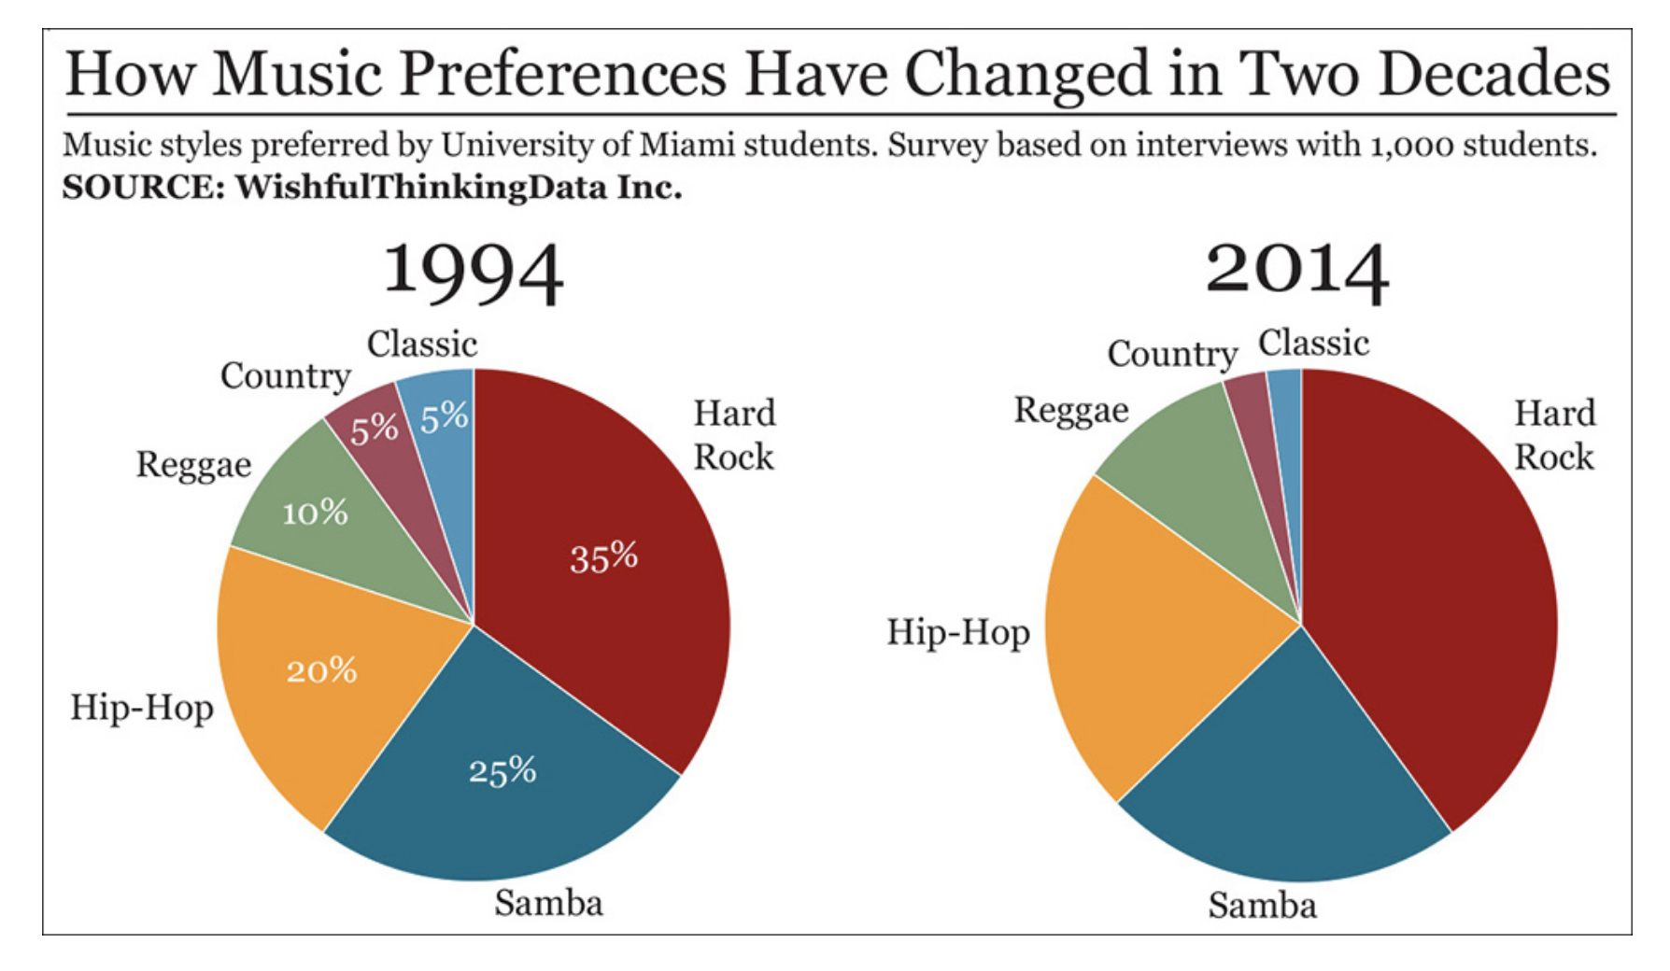
Functional: Purpose should guide design decisions

Slide 14
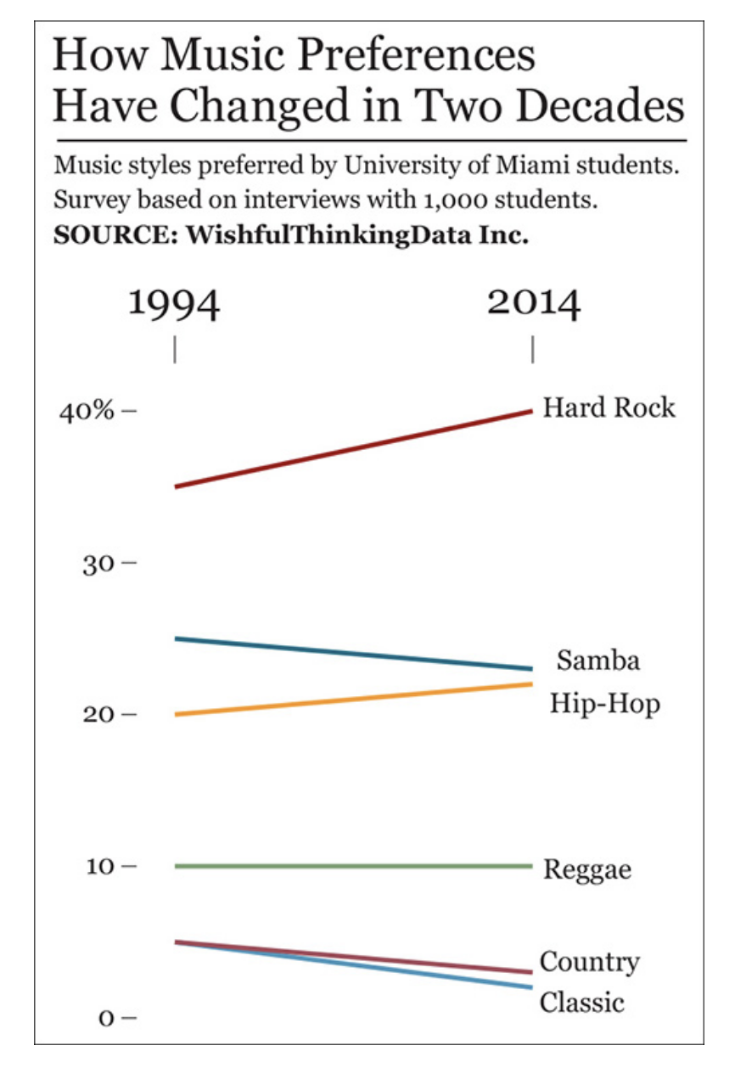
Functional: Purpose should guide design decisions
Slope chart is more effective to represent change between two points in time

Slide 15
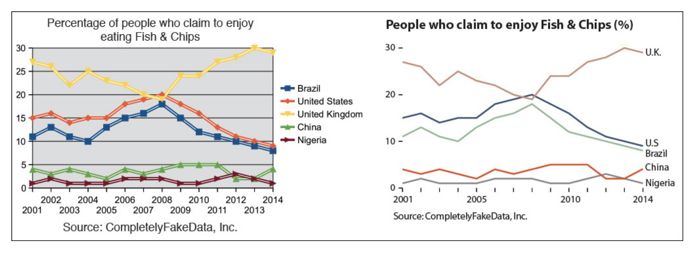
Beautiful: Which chart is more appealing?

Slide 16
Insightful: Spontaneous eureka

Slide 17
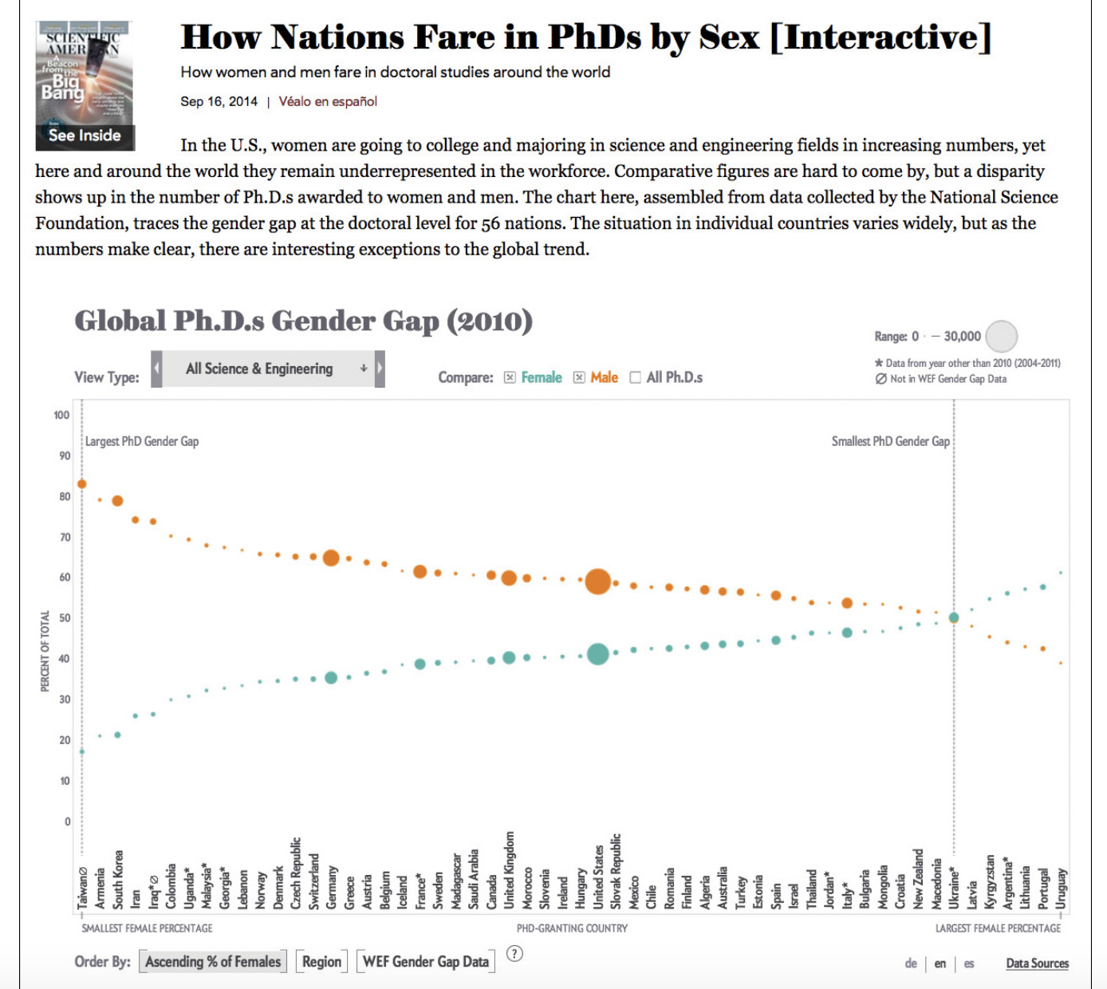
Insightful: Knowledge building

Slide 18
How to choose the best graphic form for your data
Think about the task(s) you want to enable
Try different graphic forms
Arrange the components of the graph to make as easy as possible to extract meaning from it
Test the outcomes yourself or people representative of your target audience

Slide 19
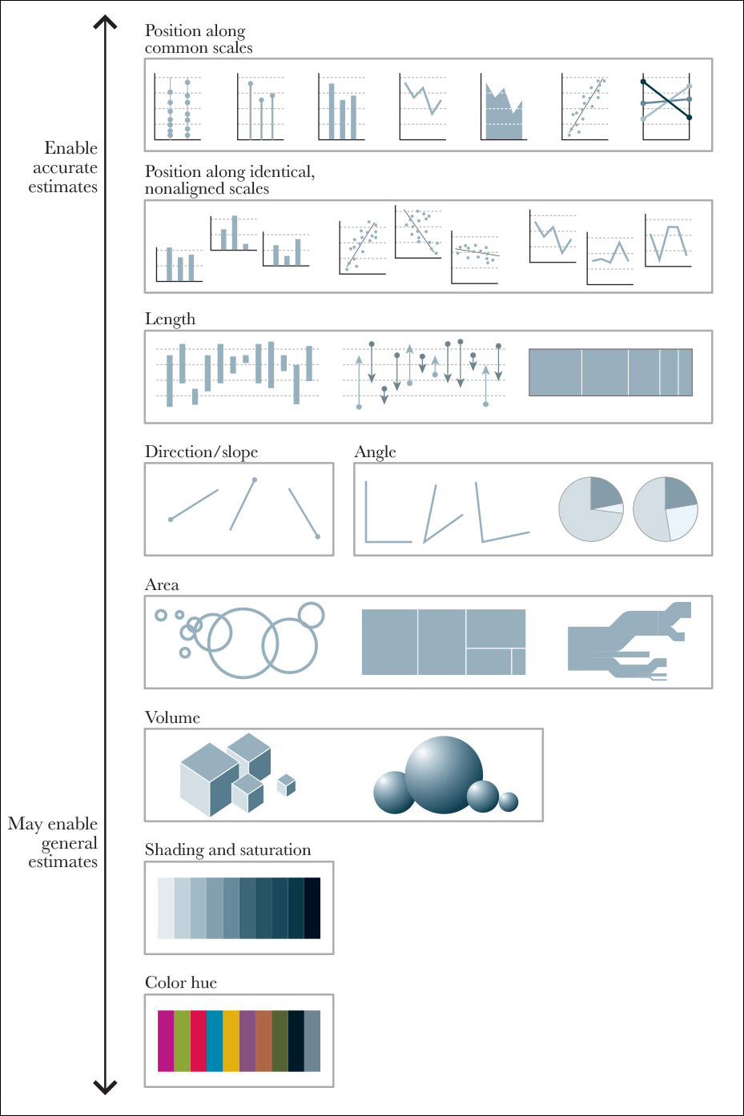
Graphical perception
Scale of elementary perceptual tasks (Cleveland & McGill)
User performs one or more of the associated mental-visual tasks to extract values represented in the plot
To create a successful chart, construct it based on tasks as high in the hierarchy as possible

Slide 20
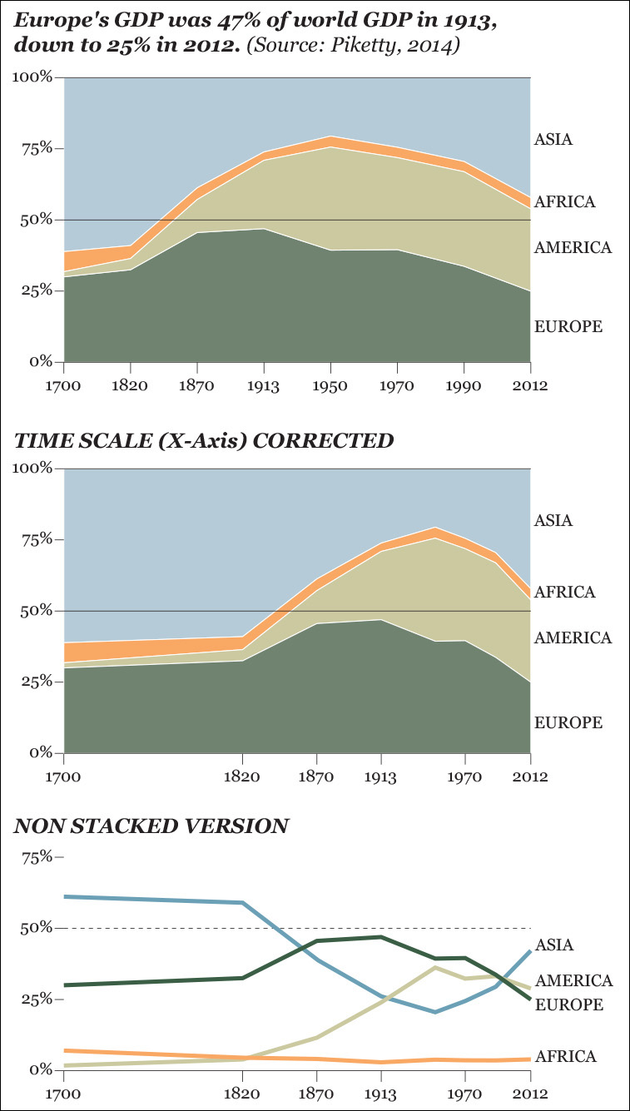
Stacked graphs, scale and non-stacked graphs

Slide 21
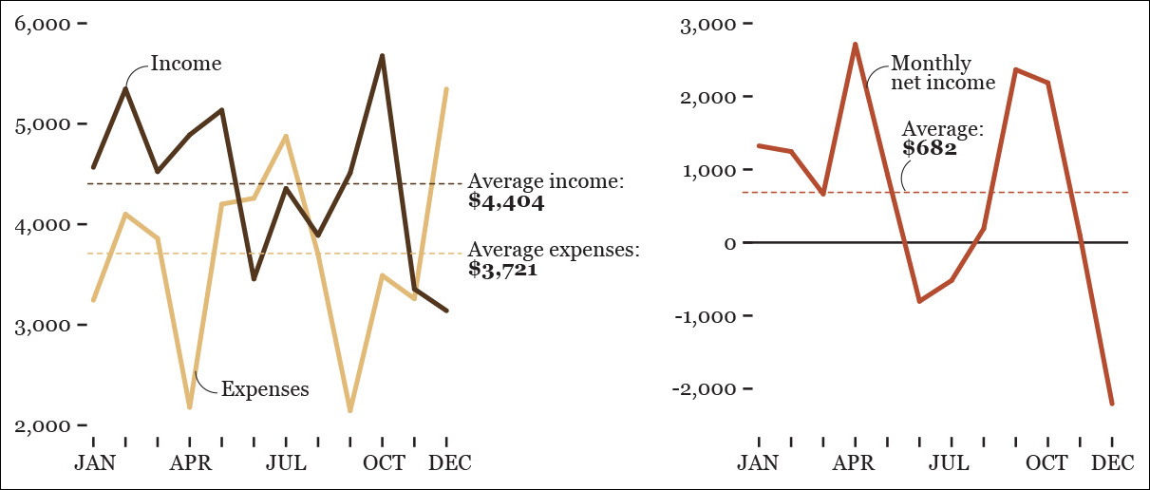
Which chart is better?
Depends on whether you want to emphasize income vs. expenses or if you want to emphasize the difference between them

Slide 22
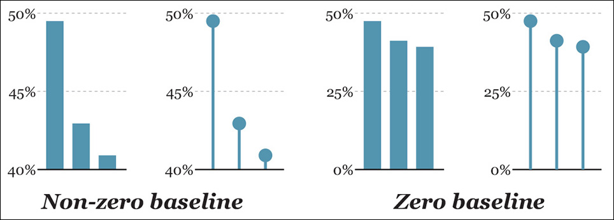
Baselines and scales of plots
Should you always include 0 in the axis as a baseline?

Slide 23
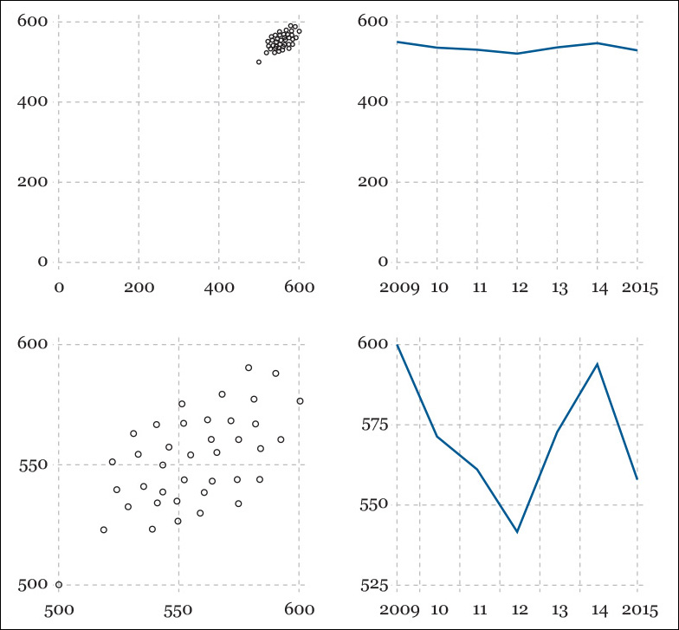
Use logical and meaningful baselines

